Slide 1

Titanic: Predict Survival On the Titanic
Group 16
Zhen Zhang
Zhaoyang Chen

Slide 2
Overview
Introduction of Dataset
Data Overview
Initial Data Analysis
Data Preprocessing
Model

Slide 3
Data Introduction
Background: The sinking of the Titanic is one of the most infamous shipwrecks in history. On April 15, 1912, during her maiden voyage, the Titanic sank after colliding with an iceberg, causing 1502 death out of 2224 passengers and crew.
Our dataset:
Comes from Kaggle
We worked with the training set
Contains the data of 891 Titanic passengers. Specifically, there are 577 females, and 314 males in this dataset.
Limitation:
The first limitation of our dataset is that several values are missing
The second limitation is the sample size is relatively small since we just use the training set

Slide 4
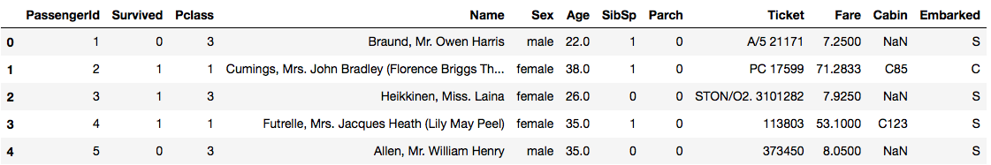
Data Overview
Data Dictionary:
Survival: Survival
Pclass: Ticket class
Sex: sex
Age: Age in years
Sibsp: # of siblings / spouses aboard the Titanic
Parch: # of parents / children aboard the Titanic
Ticket: ticket number
Fare: passenger fare
Cabin: cabin number
Embarked: Port of Embarkation

Slide 5
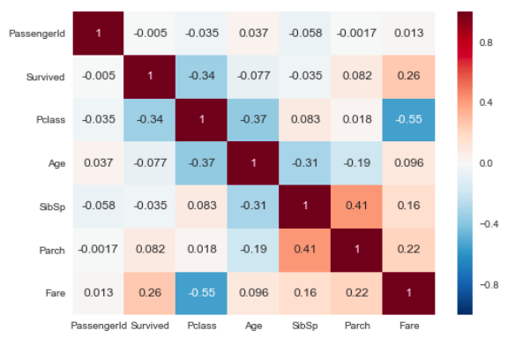
Initial Data Analysis
Here, we see the 'age', 'fare', and 'parch' are most related to 'Survived'

Slide 6
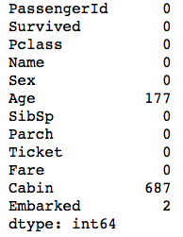
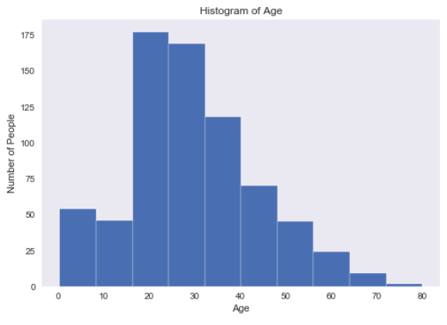
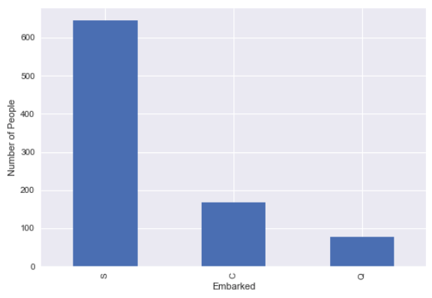
Data Preprocessing-Handling with Missing values

Slide 7
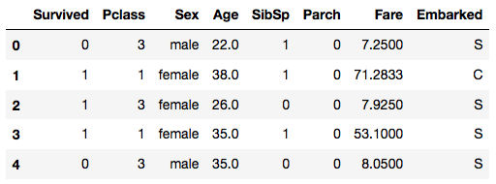
Data Preprocessing Drop Columns
We drop the ‘PassengerID’, ‘Name’, and ‘Ticket’ since they are not related to our prediction
We dropped ‘Cabin’ since it has too many missing values.

Slide 8
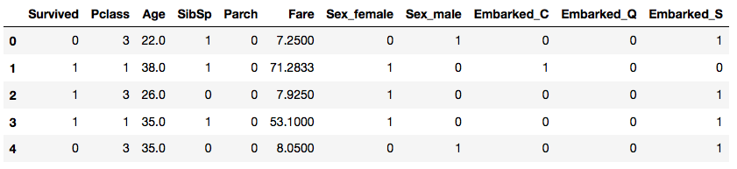
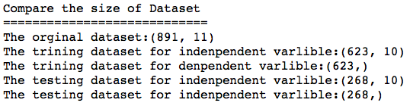
Data Preprocessing Handling Categorical Data And Partitioning a dataset

Slide 9
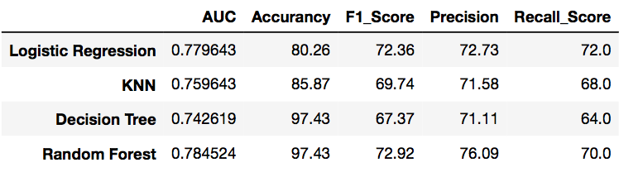
Raw Models And Model Comparison

Slide 10
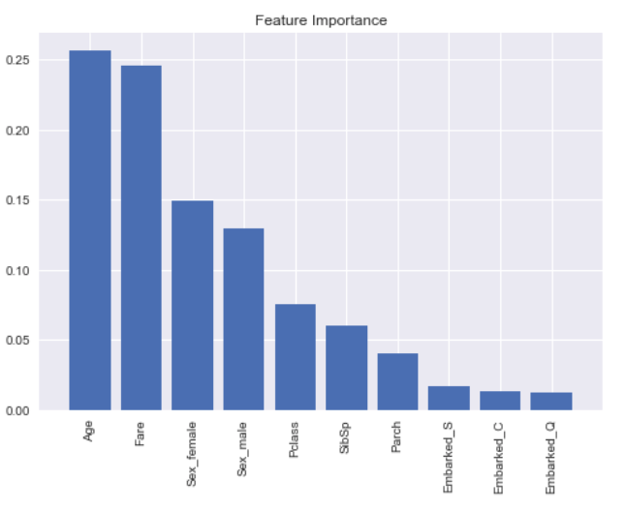
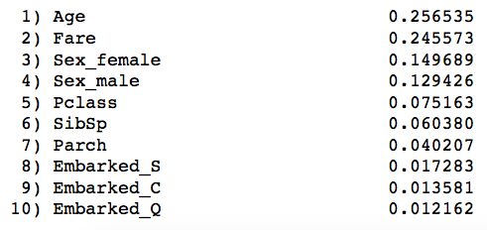
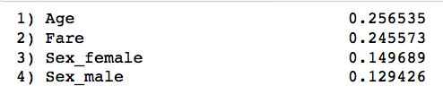
Model Optimization Feature Importance

Slide 11
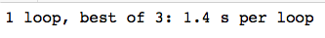
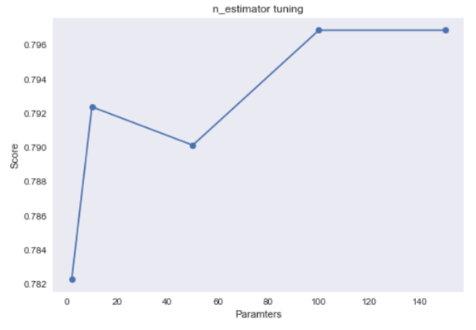
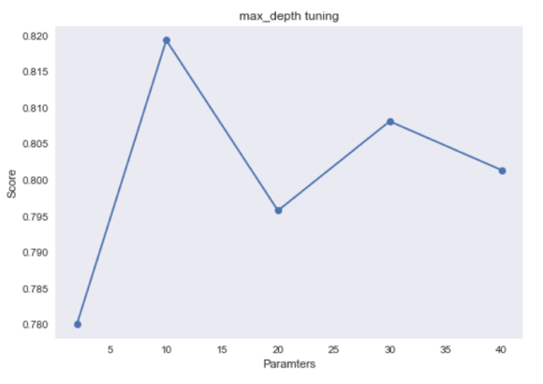
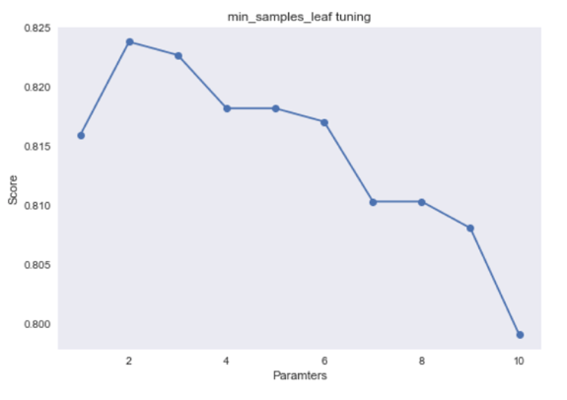
Model Optimization Parameters
n_jobs=1：
n_jobs=-1：
PARAMETERS
n_jobs | 1
n_estimators | 100
max_depth | 10
min_samples_leaf | 2

Slide 12
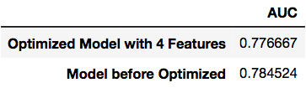
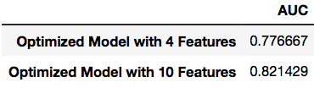
Model Evaluation
Raw Model Compare with Improved Model (4 Important Features with Parameters):
Improved Model Compare with Optimized Model (10 Features with Parameters):

Slide 13
Conclusion
We got the four important features are Age, Fare and Sex_male, and Sex_female
We found that the Random Forest model with 10 features and four parameters (n_jobs=1, n_estimators=100, max_depth=10, min_samples_leaf=2,) can give the best prediction of the probability of survival

